Slide 1
Hyperlipidemia classification summary

Slide 2
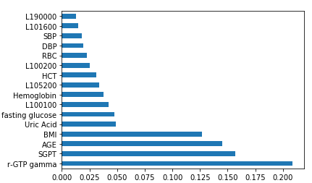
Hyperlipidemia classification
Features:
AGE
BMI
Uric Acid
Fasting glucose
L100100 - Total-Protein
SBP
DBP
L100200 - Albumin
SGPT
L190000 - WBC
L100400 - blood urea nitrogen
r-GTP gamma
RBC
HCT
Hemoglobin
L101600 - alkaline phosphatase
L105200 - glomerular filtration rate
Class boundary
Normal:
Total-cholesterol : ≤ 200mg/dL AND
LDL-cholesterol : ≤ 130mg/dL AND
Triglyceride : ≤ 150mg/dL
Hyperlipidemia: otherwise.
Total data size: 410,718
Normal: 206,263
Hyperlipidemia: 204,455
Excluded columns
Total-cholesterol
LDL-cholesterol
Triglyceride
HDL-cholesterol
Cardiac risk factor

Slide 3
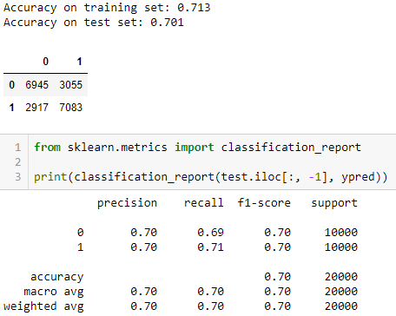
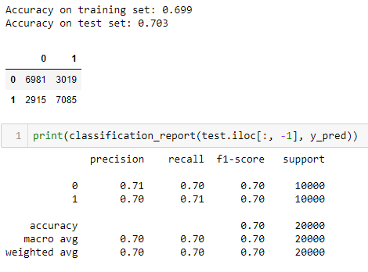
Hyperlipidemia classification
Random Forest Classifier
XGB Classifier

Slide 4
Hyperlipidemia next year prediction
Features
L100700 - Uric Acid
S000300 - BMI
L101700 - r-GTP gamma
L100800 - Fasting glucose
L103300 - Cardiac risk factor
L103100 - HDL-cholesterol
FIELD_33 - 4_1_Smoking
FIELD_38 - Drinking 5-1 days (1 week)
FIELD_40 - 6-1 of physical activity (high strength)
SEX
AGE
 | Data size
Training size | 46,263
Testing size | 11,664

Slide 5
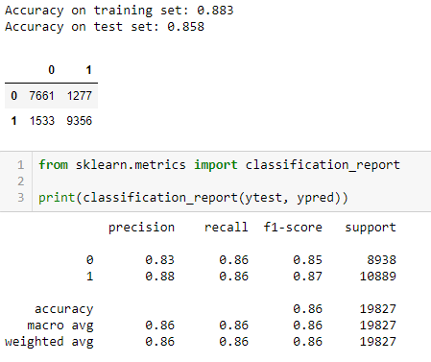
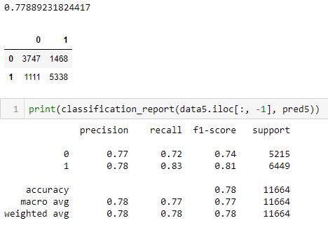
Hyperlipidemia next year prediction
Random Forest Classifier
Classifier training and prediction result on the actual data
Classifier prediction result on the next year forecasted dataset

